Slide 1
WEB SCRAPPING PROJECT
Noémie Gautier

Slide 2
THE PROJECT :
GOALS
TOPIC
Finding the average housing price for four cities:
Faches-Thumesnil (59155)
Ronchin (59790)
Wattignies (59139)
Lesquin (59810).
Learn new things
Discovering Webscrapping
Learning how to clean data
WEBSCRAPING
SELOGER.COM
CHALLENGES
All new to me
Learning how to do webscrappring
A lot of data to collect and put in a dataframe

Slide 3
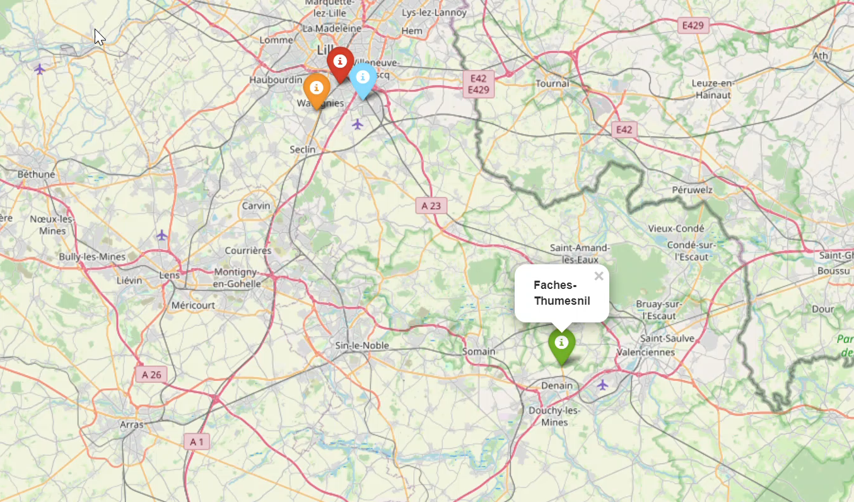
INTERACTIVE MAP:

Slide 4
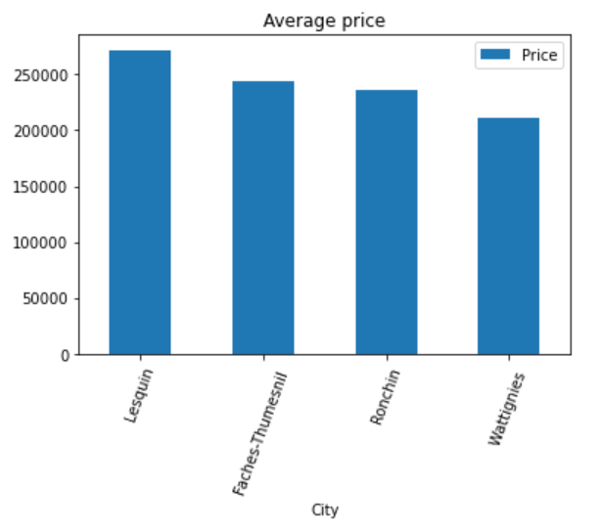
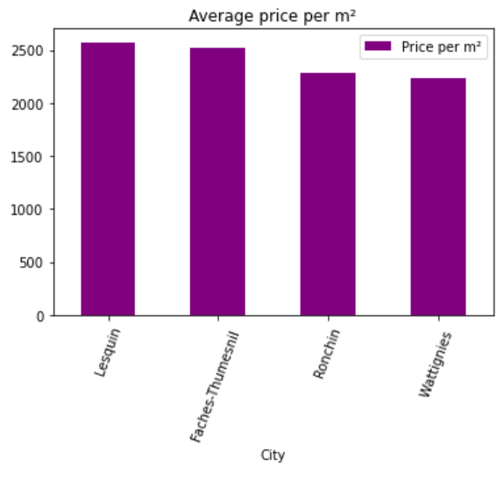
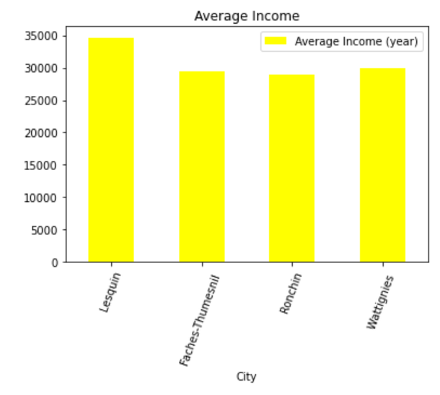
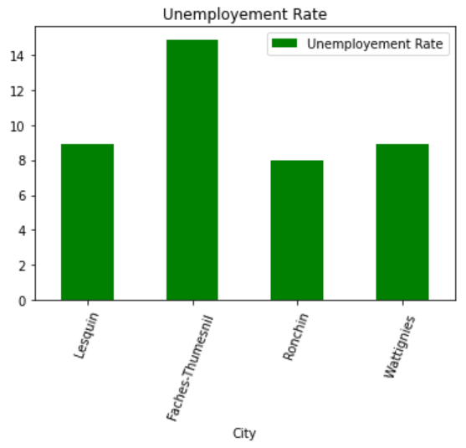
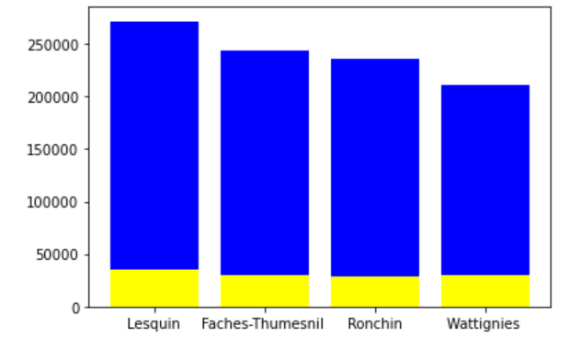
THE FINAL OUTPUT:
Average Housing Price vs Income:
Notes:
How would this help me make my decision?

Slide 5
BUILDING THE PRODUCT:
Create a list and Data Frame to access all of the data collected
Multiple calculations to get the average prices per squared meter for each town
ACCESS DATA
CALCULATIONS
COLLECT DATA
CLEAN DATA
VIZUALISATION
WebScrapping to collect the data from SeLoger.com for the 4 different cities
Created multiple graphs and a map based on the results of the calculations and the initial table as well as some demographic inofrmation I collected
Add column titles, new columns, split column in different parts, changing Data Types

Slide 6
THANKS
Any Questions?

